Slide 1
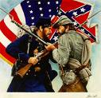
Civil War Facts

Slide 2
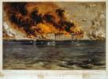
The Basics 1. Started : April 12, 1861, Ft. Sumter, SC Ended: April 9, 1865, Appomattox, VA 2. Known as: War between the States War of rebellion War of secession War of Southern Independence 3. More lives were lost in the Civil War, than any other war in American History. Deadliest: Gettysburg, 58,000 deaths 4. Civil War ended Southern way of life.

Slide 3
5. Introduced: telegraph, photograph and ironclads. 6. NC sent the most soldiers in the entire Confederacy. NC had more deserters than any other state. 7. Goal: South: Maintain Independence North: Preserve the Union.

Slide 4
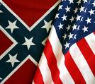
Union vs. Confederate Strategies

Slide 5
Union
Blockade all Confederate Ports
a. Keep Confederacy from selling abroad
b. Prevent them from getting war supplies
Seize the Mississippi River
a. Split the Confederacy
(Arkansas, Louisiana, Texas: Stranded)
Known as: ANACONDA PLAN
3. Destroy the Confederate armies and land
a. Winning strategy
b. Stop civilians from supporting the war.
4. Stop the European nations from recognizing
the Confederacy.

Slide 6
Confederacy
Wear down the invading armies.
Northerners would get tired of the war.
2. Make sure blockades didn’t succeed by
use of ironclad ships.
3. “King Cotton Diplomacy”
British and French needed South’s cotton. If they (South) quit selling the cotton, it would force the British and French to help the South break through the blockades to get to the cotton. Unsuccessful !!!

