Slide 1
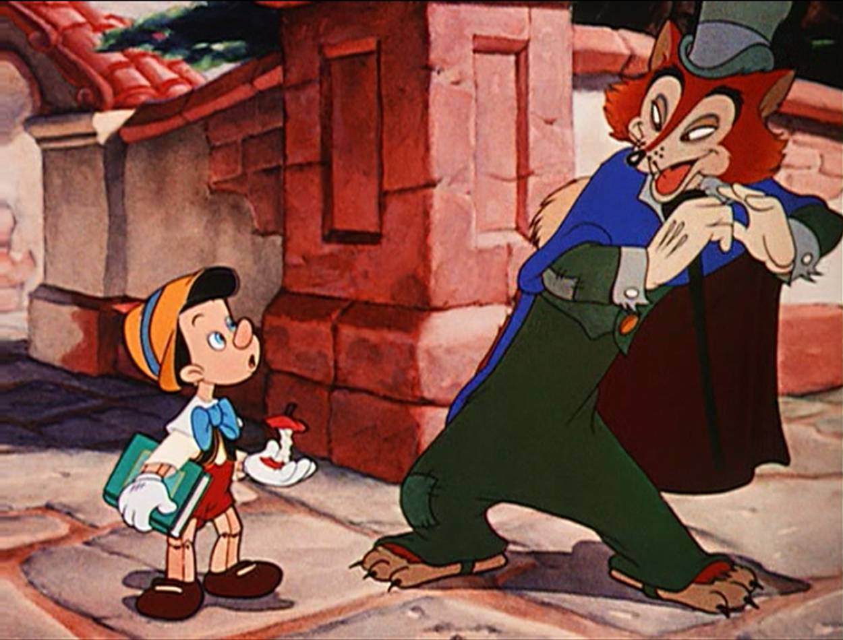
What’s that Tone?
An Analysis Activity
Follow the directions on the next slides………
Created by Courtney Rudder WCPSS

Slide 2
On the following slides you will analyze some text for mood and tone. Discuss the text together. Use the mood and tone words on the next slide to help you, ….but think of your own words as well! (There is a “cheat sheet” of mood and tone words also.)
The Text gets progressively more challenging. Are you up to it?

Slide 3
Some Words That Describe Tone
Amused Humorous Pessimistic Angry Informal Playful Cheerful Ironic Pompous Horror Light Sad Clear Matter-of-fact Serious Formal Resigned Suspicious Gloomy Optimistic Witty
Some Words That Describe Mood
Fanciful Melancholy Frightening Mysterious Frustrating Romantic Gloomy Sentimental Happy Sorrowful Joyful Suspenseful

Slide 4
Here is some text for you to analyze. The first one is an example that is completed for you. Finish the rest in the same format. Collaborate with each other!
Bouncing into the room, she lit up the vicinity with a joyous glow on her face as she told about her fiancé and their wedding plans.
See example answer here
Tone: The tone seems playful and upbeat. The author’s attitude is probably optimistic and light.
Evidence: “She lit up the vicinity with a joyous glow..” “Bouncing into the room” –very playful!
Mood: This makes the reader feel a bit romantic and joyful
Evidence: “joyous glow on her face as she told about her fiance and their wedding plans…” Obviously this sets a mood of happiness and giddiness. As the reader I feel like I should celebrate!
She huddled in the corner, clutching her tattered blanket and shaking convulsively, as she feverishly searched the room for the unknown dangers that awaited her.
Tone:
Evidence:
Mood:
Evidence:

Slide 5
Gently smiling, the mother tenderly tucked the covers up around the child’s neck, and carefully, quietly, left the room making sure to leave a comforting ray of light shining through the opened door should the child wake.
Tone:
Evidence:
Mood:
Evidence:
Drawing the attention of his classmates as well as his teacher, the student dared to experiment with his professor’s intelligence by interrogating him about the Bible.
Tone:
Evidence:
Mood:
Evidence:

Slide 6
Bursting through the door, the flustered mother screamed uncontrollably at the innocent teacher who gave her child an F.
Tone:
Evidence:
Mood:
Evidence:
He furtively glanced behind him, for hear of his imagined pursuers, then hurriedly walked on, jumping at the slightest sound even of a leaf crackling under his own foot.
Tone:
Evidence:
Mood:
Evidence:

Slide 7
The laughing wind skipped through the village, teasing trees until they danced with anger and cajoling the grass into fighting itself, blade slapping blade, as the silly dog with golfball eyes and flopping, slobbery tongue bounded across the lawn.
Tone:
Evidence:
Mood:
Evidence:
TO what purpose, April, do you return again?
Beauty is not enough.
You can no longer quiet me with the redness
Of little leaves opening stickily.
Tone:
Evidence:
Mood:
Evidence:

Slide 8
To enter out into that silence that was the city at eight o'clock of a misty evening in November, to put your feet upon that buckling concrete walk, to step over grassy seams and make your way, hands in pockets, through the silences, that was what Mr Leonard Mead most dearly loved to do.
Tone:
Evidence:
Mood:
Evidence:
Hattie Carroll was a maid of the kitchen She was fifty-one years old and gave birth to ten children Who carried the dishes and took out the garbage And never sat once at the head of the table And didn’t even talk to the people at the table Who just cleaned up all the food from the table And emptied the ashtrays on a whole other level
Tone:
Evidence:
Mood:
Evidence:

Slide 9
Back into the chamber turning, all my soul within me burning, Soon again I heard a tapping somewhat louder than before. "Surely," said I, "surely that is something at my window lattice; Let me see, then, what thereat is, and this mystery explore – Let my heart be still a moment and this mystery explore; – 'Tis the wind and nothing more!"
Tone:
Evidence:
Mood:
Evidence:
One dollar and eighty-seven cents. That was all. And sixty cents of it was in pennies. Pennies saved one and two at a time by bulldozing the grocer and the vegetable man and the butcher until one's cheeks burned with crimson colors. Three times Della counted it. One dollar and eighty- seven cents. And the next day would be Christmas.
Tone:
Evidence:
Mood:
Evidence:

