Slide 1
The Road to the Civil War

Slide 2
Missouri Compromise
Henry Clay persuades Congress to adopt the Missouri Compromise
Admits Maine into Union as a free state
Admits Missouri into Union as a slave state
Louisiana Territory north of the southern border of Missouri would be free of slavery (Except for Missouri)
Gave southern slave owners a clear right to pursue escaped fugitives into “free” regions and return them to slavery.

Slide 3
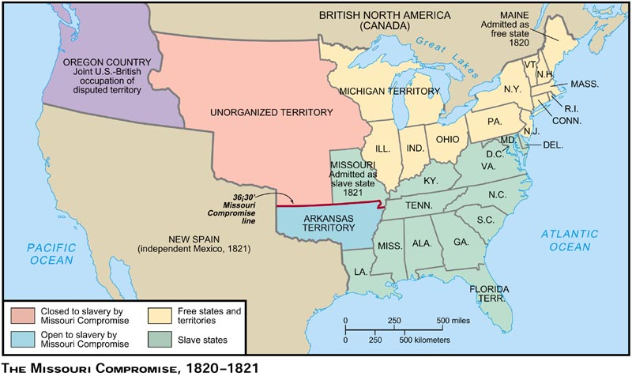
Map Used as an educational resource from Pearson; accessed at: http://wps.ablongman.com/long_divine_appap_7/23/5933/1518971.cw/content/index.html

Slide 4
Missouri Compromise
Revealed sectional rivalries among the Union
Seemed to balance interest of North and South
White southerners not happy Congress gave itself power to make laws about slavery
Northerners angry Congress had allowed slavery into another state

Slide 5
The Abolitionist Movement
Abolitionist believed slavery violated the most basic principle of the Declaration of Independence, “that all men are created equal.”
Wanted to abolish, or end, slavery
By 1804 all northern states had ended or pledged to end slavery
Congress outlawed slavery in Northwest Territory
Ohio entered Union in 1803; first state to ban slavery in constitution
William Lloyd Garrison was a forceful voice for abolition
Frederick Douglass was most powerful speaker for abolitionism

Slide 6
The Underground Railroad
A network of people—black and white, northerners and southerners—who secretly helped slaves reach freedom
Working the Railroad was illegal and dangerous
“Conductors” led fugitive slaves from one “station” to the next
“Stations” were usually homes of abolitionists; could be churches or caves
Supporters helped by donating food, clothing, and money to pay for passage on trains and boats
Levi Coffin, an Indiana Quaker, assisted more than 3,000 fugitives
Harriet Tubman helped more than 300 people to freedom
“Black Moses”
Slave owners promised a $40,000 reward for her capture

Slide 7
Compromise of 1850
Henry Clay proposed a compromise that would quiet controversy over slavery
Sept. 1850 Congress passes five bills based on Clay’s proposals
To please the North:
California admitted to Union as a free state
Banned slave trade in nation’s capital
To please the South:
Popular Sovereignty used to decide question of slavery in rest of Mexican Cession
In return for agreeing to outlaw slave trade in Washington, D.C., southerners had new fugitive slave law (Fugitive Slave Act of 1850)

Slide 8
The Fugitive Slave Act
Allowed special government officials to arrest any person accused of being a runaway slave
Suspects had no right to trial
All that was required to deprive them of their freedom was for a slaveholder or any white witness to swear that the suspect was the slaveholder’s property
Required northern citizens to help capture accused runaways if authorities requested assistance
Became most controversial part of the Compromise of 1850
John C. Calhoun (SC) hoped this law would force northerners to admit that slaveholders had rights to their property

Slide 9
Uncle Tom’s Cabin
Harriet Beecher Stowe, a northerner and daughter of an abolitionist minister who saw many people who had escaped from slavery, wanted to write, “something that will make this whole nation feel what an accursed thing slavery is.”
Published in 1852, the novel was about Uncle Tom, an enslaved man who is abused by the cruel Simon Legree.
The novel was a bestseller in the North, shocking thousands previously unconcerned with slavery
White southerners were outraged by the book, criticizing it as propaganda for abolitionists
Readers began to view slavery as more than just a political conflict, and see that it was a moral problem

Slide 10
Kansas-Nebraska Act
Stephen Douglas, a senator from Illinois, wanted to see a railroad built from Illinois through the Nebraska Territory to the Pacific Coast
Suggested forming two new territories—Kansas Territory and the Nebraska Territory
Southerners objected because both territories were in an area closed to slavery by the Missouri Compromise
States created from these territories would enter Union as free states

Slide 11
Kansas-Nebraska Act
To win southern support, Douglas suggested that slavery in the new territories be decided by popular sovereignty
In effect, the Kansas-Nebraska Act undid the Missouri Compromise
Southern support was gained but northerners were outraged believing that Douglas had betrayed them by reopening the issue of slavery in the territories

Slide 12
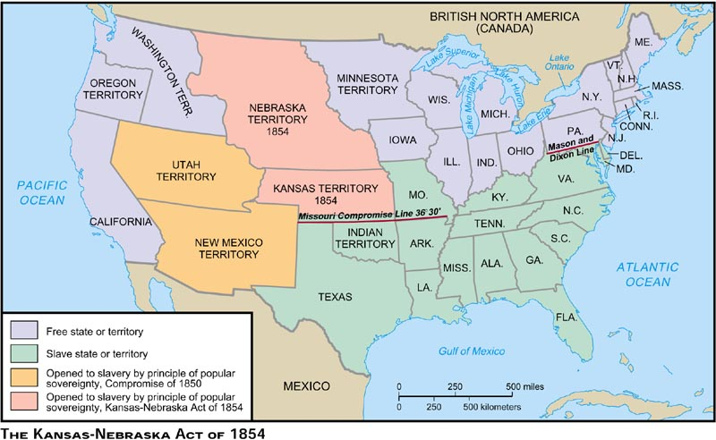
Map Used as an educational resource from Pearson; accessed at: http://wps.ablongman.com/wps/media/objects/1483/1518969/DIVI269.jpg

Slide 13
Bleeding Kansas
Kansas-Nebraska Act left it to white citizens to decide whether Kansas would be a free or slave state
Proslavery and antislavery settlers flooded into Kansas within weeks; each side determined to hold the majority in the territory
Kansas had only 3,000 voters but, nearly 8,000 votes were cast on election day
Of the 39 legislators elected, all but 3 supported slavery
Antislavery settlers refused to accept these results and held a second election

Slide 14
Bleeding Kansas
Kansas now had two governments, each claiming the right to impose their government on the territory
April: A proslavery sheriff was shot when he tried to arrest some antislavery settlers in the town of Lawrence
The next month, he returned with 800 men and attacked the town
Three days later John Brown, an antislavery settler from Connecticut led seven men to a proslavery settlement Pottawatomie Creek, murdering five proslavery men and boys

Slide 15
Violence in Congress
The violence of Kansas spilled over into the Senate
Charles Sumner of Massachusetts was the leading abolitionist senator
Sumner denounced proslavery legislature in Kansas, then attacking his southern enemies—singling out Andrew Butler and elderly senator from South Carolina
Butler was not present at the time of the speech
Days later, Butler’s nephew, Congressman Preston Brooks, marched into the Senate chamber and with a heavy cane, Brooks beat Sumner until he fell to the floor, bloody and unconscious
Hundreds sent canes to Brooks to show support
Sumner never fully recovered from injuries

Slide 16
The Dred Scott Decision
Dred Scott was an enslaved person who had once been owned by a U. S. Army Doctor living in Illinois and Wisconsin Territory
Slavery was illegal in both places
After leaving the Army, the doctor settled with Scott in Missouri
With help from antislavery lawyers, Scott sued for his freedom claiming that he was free because he had lived where slavery was illegal

Slide 17
The Dred Scott Decision
The Court’s Decision:
The Court said Scott was not a free man for two reasons
Scott had no right to sue in federal court because African Americans were not citizens
Living in a free territory did not make an enslaved person free
Slaves were considered property, and property rights were protected by the U. S. Constitution
Further, the Court said that Congress did not have the power to prohibit slavery in any territory, thus the Missouri Compromise was unconstitutional
Supporters of slavery rejoiced at decision; said slavery was legal in all territories
Antislavery supporters condemned the ruling

Slide 18
Lincoln-Douglas Debates
Lincoln served in the Illinois state legislature as a Whig; after a single term he returned to Illinois to practice law
His opposition to the Kansas-Nebraska Act brought him back into politics, embracing the Republican cause
He had been a long time rival of Illinois Senator Stephen Douglas
1858, Lincoln was chosen to run for the Senate against Douglas
Lincoln then challenged Douglas to a series of debates

Slide 19
Lincoln-Douglas Debates
Douglas strongly defended popular sovereignty
Painted Lincoln as a dangerous abolitionist who wanted equality for African Americans
Lincoln took a stand against the spread of slavery
Thought Americans were obligated to keep slavery out of the western territories
Said slavery would die out on its own
Douglas won the Senate election, but the debates made Lincoln known throughout the country

Slide 20
John Brown’s Raid
Brown returned to New England after being driven out of Kansas after the Pottawatomie Massacre
He plotted to raise an army and free people in the South who were enslaved
1859, Brown and a small band of supporters attacked the town of Harpers Ferry in VA
Goal was to seize guns the U.S. Army had stored there
He thought enslaved African Americans would support him and he would then give them weapons and lead them in a revolt
Brown quickly gained control of the arms but troops, Commanded by Robert E. Lee, surrounded Brown’s force before it could escape
10 of Brown’s followers were killed
Brown was wounded and captured

Slide 21
Election of 1860
Republicans chose Abraham Lincoln as presidential candidate
His criticism of slavery had during debates with Douglas had made him popular in the North
Southern Democrats wanted the party to support slavery in the territories but northerners refused to do so.
Party splits
Northern Democrats chose Stephen Douglas
Southern Democrats chose Vice President John Breckinridge of Kentucky
Southerners still hoping to heal the split between North and South formed the Constitutional Union Party and nominated John Bell of Tennessee, who promised to protect slavery and keep the nation together

Slide 22
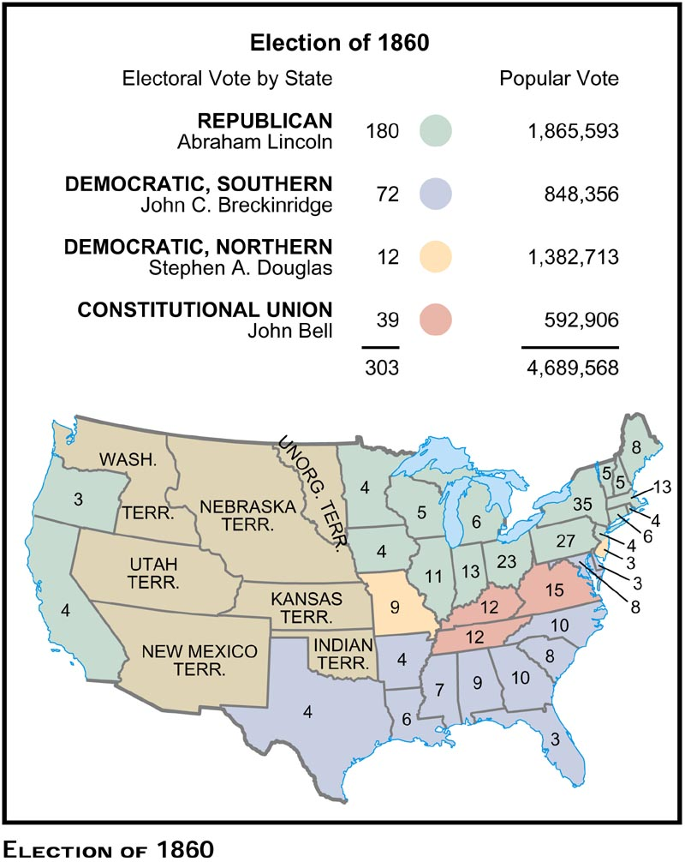
Election of 1860
Lincoln won every free state
Breckinridge won all the slave states except four
Bell won Kentucky, Tennessee, and Virginia—all upper south
Douglas carried only Missouri
Lincoln receive 40% of the popular votes, but received enough electoral votes to win the election
Map Used as an educational resource from Pearson; accessed at: http://wps.ablongman.com/wps/media/objects/1483/1518969/DIVI281.jpg

Slide 23
Results
Southern States Secede
Lincoln’s election shocked the South
Many thought the South would have no voice in government
South Carolina was first to secede from the Union
The Confederate States of America
Six states followed SC
In February, leaders from the seven seceding states met in Montgomery, Alabama, to form a new nation they called the Confederate States of America
By the time Lincoln took office in March, they had written a constitution and named former Mississippi Senator Jefferson Davis as their president

