Slide 1
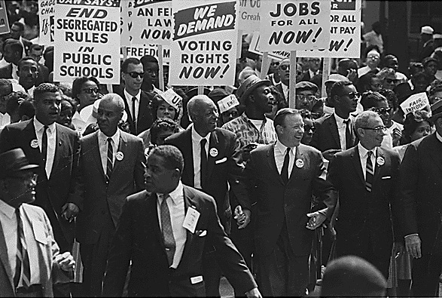
Civil Rights Movement

Slide 2
Civil War Amendments
13th: 1865 Abolished slavery
14th: 1869 Established citizenship
15th: 1870 All men could vote
Almost a hundred years later and African Americans were still not given the same rights and freedoms that the Constitution promises. Before the Civil Rights movement, the country was segregated, there were voting restrictions, and many were discriminated against.

Slide 3
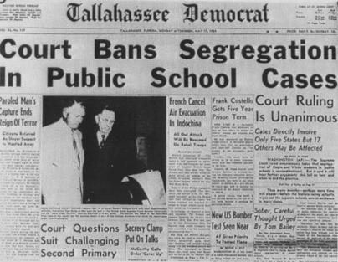
Brown v. Board of Education
Free and Equal Public Education wasn’t always available to everyone.
The journey to equality in education began with a court case called Plessy v. Ferguson in Topeka, KS

Slide 4
Brown v. Board of Education
Plessy v. Ferguson
This case began when an African American man was forced to move to the back of a train traveling south.
He sued the train company for requiring him to move to the back based on his skin color
The court ruled that the company could segregate their trained as long as the facilities were equal.
This “Separate but Equal” ruling set the precedent in many other cases and allowed for segregation to continue.

Slide 5
Brown v. Board of Education
In 1954, a young girl and her father challenged the Plessy v. Ferguson ruling.
The little girl had to walk miles away to a school for African Americans that was not adequate instead of the nicer school that was close to her house.
The family won the case when the judge declared separate was NOT equal.
This case was a great first step, however, restaurants and stores could sill segregate. It also gave no specific time for school to integrate.

Slide 6
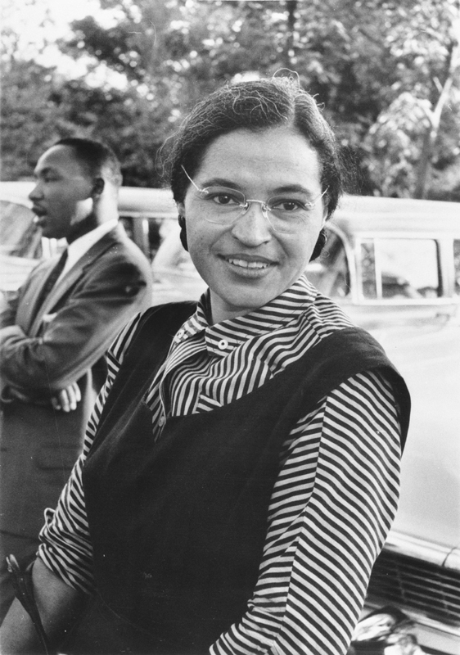
Montgomery Bus Boycott Rosa Parks
In 1955, Rosa Parks was arrested for refusing to move to the back of the bus.
A boycott follows, leading to desegregation.
A boycott is an organized campaign to refuse to buy or use certain goods and services

Slide 7
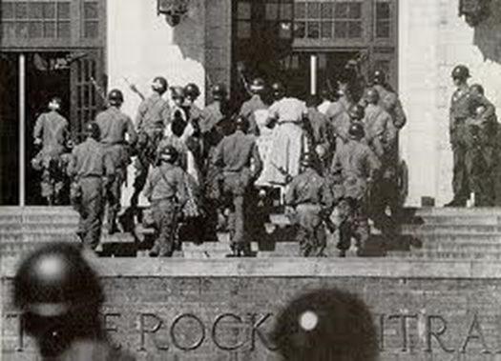
The Little Rock Nine
In 1957, President Eisenhower sent federal troops to Central High School in Little Rock, Arkansas after the governor of Arkansas used the National Guard to deny entrance to African-American students.

Slide 8
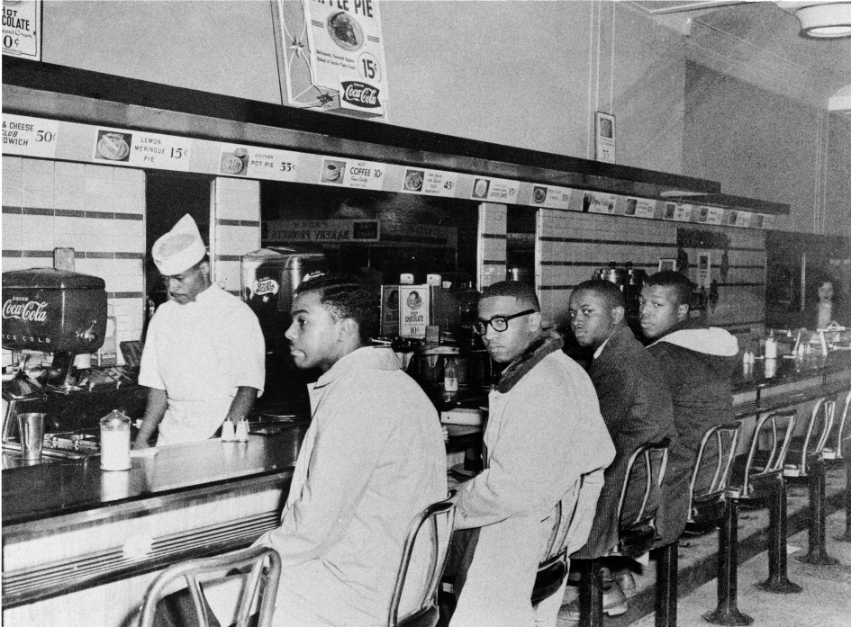
Greensboro Sit In (1960)
Four young African American college freshman staged a nonviolent protest of segregated establishments in North Carolina.
They four students sat down at a lunch counter in an all white establishment in downtown Greensboro
Even though they were denied service, the Greensboro four refused to give up their seats.
Police arrived but were unable to take action because the men were protesting in a non violent manner. Local and national news were called.

Slide 9
Greensboro Sit In
The four stayed until closing and retuned the next day, continuing in their nonviolent manner. More students soon joined the original four.
By the firth day, some 300 students had joined the protest.
Soon these nonviolent movements spread across the south, bringing national attention to segregation in the south.
The all white establishment was forced to integrate- they could not continue to ignore hundreds of men and women

Slide 10
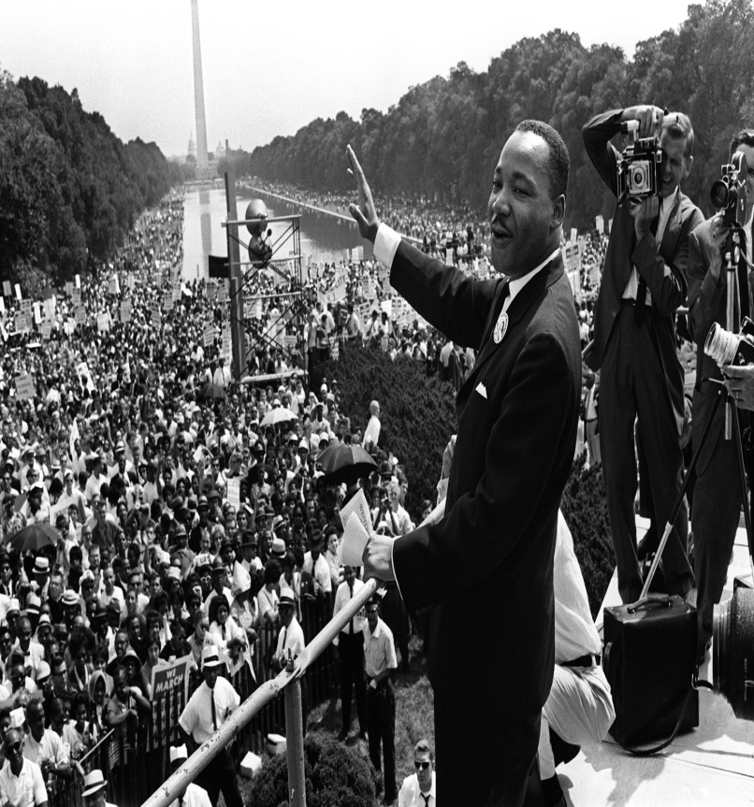
March on Washington
On August 28, 1963, more than 200,000 Americans gathered in Washington, D.C. to shed light on the political and social challenges African Americans faced.
Dr. Martin Luther King Jr delivered his famous “I have a dream” speech which called for racial justice and equality.

Slide 11
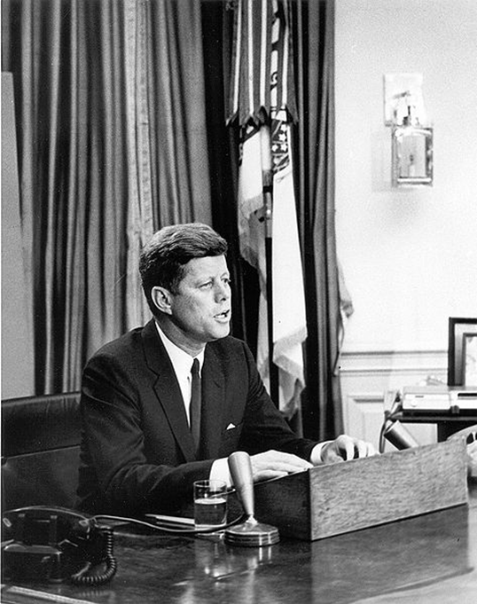
Civil Rights Act 1964
John F. Kennedy originally asked for a bill "giving all Americans the right to be served in facilities which are open to the public—hotels, restaurants, theaters, retail stores, and similar establishments,” in his civil rights speech on June 11th, 1963.

Slide 12
Civil Rights Act 1964
The Bill:
Banned racial discrimination in employment
Provided greater protection to black voters
Eliminated segregation in a publically owned facilities (not just schools
Strengthened the anti-segregation clauses regarding public facilities; such as lunch counters
Gave authorization for the Attorney General to file lawsuits to protect individuals against “the deprivation of any rights secured by the Constitution or U.S law.”

Slide 13
Civil Rights Act 1964
Issues Getting the Bill Passed:
The bill was moved to the House of Representatives Rules Committee, whose chairman vowed to keep the bill from leaving the committee or passing
President Kennedy, who had been pushing for this bill, was assassinated in November 1963.
President Johnson’s (Kennedy’s VP) first address said that the greatest way to honor President Kennedy would be to pass the Civil Rights Bill

Slide 14
Civil Rights Act 1964
The Bill was passed in the House of Representatives 290-130
The Bill then moved on to the Senate in March of 1964 where 18 Southern Senators launched a filibuster to prevent the bill from passing
Filibuster: a prolonged speech that prevents a bill becoming a law.
The filibuster lasted for 54 days
On June 19, 1964, the Senate Voted to pass the Bill 71-29
President Johnson signed it into law on July 2, 1964

Slide 15
March at Selma
1965 Dr. Martin Luther King Jr launched a protest about African Americans right to vote in Selma, Alabama
He believed the right to vote without fear or difficulty was vital if civil rights were to be won
Voter registration qualifications in the South often made it impossible for Blacks to vote
Why Selma?
In Selma only 324 out of 15,000 African Americans were registered to vote. (Those who attempted to register were prevented)
Governor of Alabama, George Wallace promised “Segregation forever!”

Slide 16
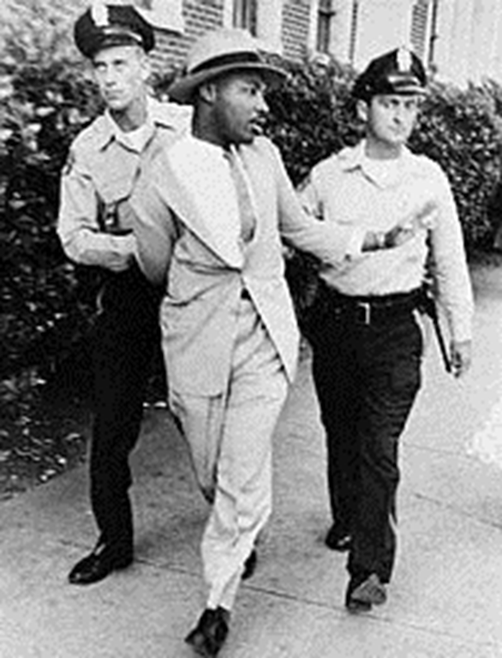
March at Selma
A month before the planned march, Dr. King deliberately got himself arrested.
He recently won the Nobel Peace Prize and his arrest would bring publicity to their cause.

Slide 17
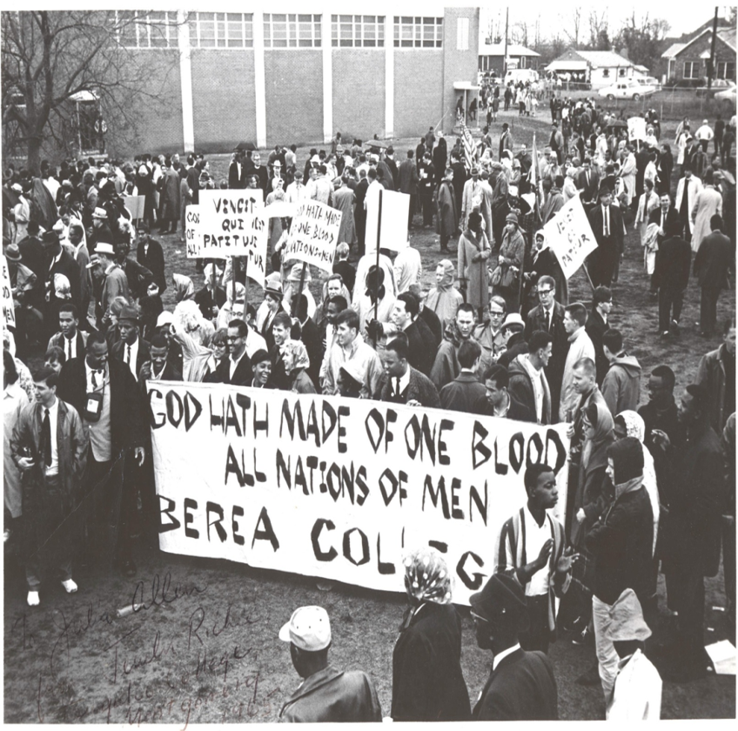
March at Selma
The March began on March 7, 1965 and the goal was to march from Selma to Birmingham.
600 marchers were met by 200 state troopers and local police armed with tear gas, sticks, and whips.
When the marchers refused to turn back they were attacked. 17 marchers were hospitalized
March 21st the march began again and this time were protected by U.S. troops.
The marchers reached Birmingham March 25th.

Slide 18
Voting Rights Act 1965
August 1965 Congress passed the Voting Rights Act
This act removed various barriers to voting registrations
Within three years most of the African American population of the South were registered to vote
White politicians need African American votes to stay in power
Some African Americas saw this as an opportunity to become politicians themselves

Slide 19
Voting Rights Act 1965

Slide 20
Martin Luther King Jr.’s Assassination

Slide 21
Dr. Martin Luther King Jr.’s Assassination
In the spring of 1968, Dr. King was in Memphis, TN to support the sanitation workers’ strike.
On April 3, 1968, King was standing on the second-floor balcony of the hotel where he was staying, when he was fatally hit by a sniper bullet.
Shock and distress over the news of King’s death sparked violent rioting in more than 100 cities around the country.
President Johnson urged Americans to stop the violence because King believed strongly in the nonviolent movement. He also urged congress to pass the Civil Rights Act of 1968 as a legacy to Dr. King.
The Act, also known as the Fair Housing Act was passed.

