Slide 1
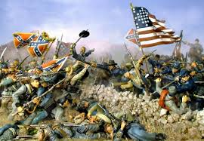
Civil War Battles

Slide 2
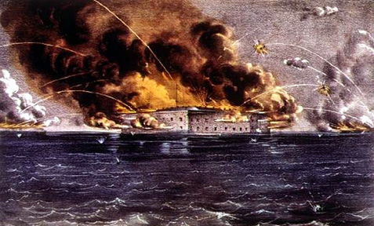
Fort Sumter
Date: April 12, 1861
Location: Fort Sumter, South Carolina
Commanding Officer(Confederate): General Bueagard
Commanding Officer (Union): General Anderson
Results: After two days, the North surrendered to the South. Only one soldier was killed when a cannon backfired during the surrendering ceremony.

Slide 3
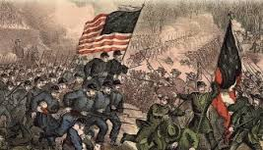
Bull Run
First Battle of Bull Run
Date: July 21, 1861
Location: Manassas, VA
Commanding Officer(Confederate): General Bueagard & Stonewall Jackson
Commanding Officer (Union): General McDowell
Results: North lost 387 soldiers and the South lost 460. The South won the battle
Second Battle of Bull Run
Date: August 29-30,1862
Location: Manassas, VA
Commanding Officer(Confederate): General Stonewall Jackson
Commanding Officer (Union): General John Pope
Results: North lost 16,000 soldiers and the South lost 9,000. The South won the battle

Slide 4
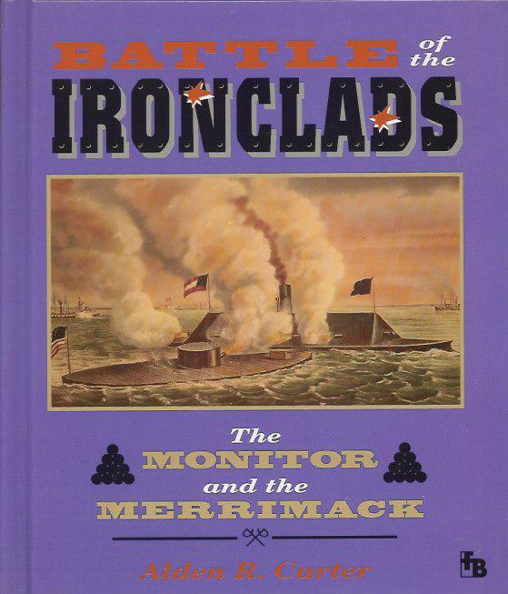
Ironclads: Monitor v. Merrimac
Date: March 8-9, 1862
Location: Hampton Roads, VA
Commanding Officer(Confederate): Officer Louis M. Goldsborough
The South had built an iron ship called the Merrimac or the Virginia.
Commanding Officer (Union): Lieutenant Catesby ap Roger Jones
The North challenged the Confederate ship with the northern iron ship called the Monitor.
Results: The two iron ships fought for 5 hours and even collided 5 times. Neither side won except the North kept the South from getting supplies from the rest of the world.

Slide 5
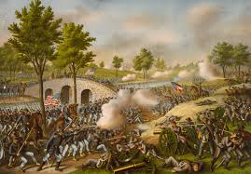
Antietam/Sharpsburg
Date: September 17, 1862
Location: Sharpsburg, Md
Commanding Officer(Confederate): General Robert E. Lee
Commanding Officer (Union): General McCleellan
Results: The battle is known as the Single bloodiest day in the Civil War. 23,500 men were killed in the Bloody lane. The name of the bridge where the confederates held the Yankees for 4 hours is called, Burnside. The south used rocks when they ran out of ammunition. South won the battle.

Slide 6
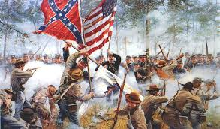
Gettysburg
Date: July 1-3, 1863
Location: Gettysburg, PA
Commanding Officer(Confederate): General Robert E. Lee
Commanding Officer (Union): General George Meade
Results: There was between 46,000 and 51,000 casualties. The North won this battle after Lee retreated. On November 19,1863. President Lincoln gave Gettysburg Address dedicating the land to the fallen Union soldiers.

Slide 7
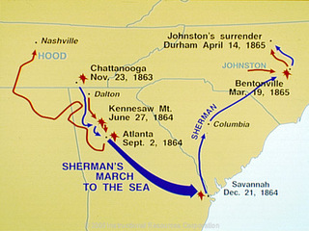
Sherman’s March

Slide 8
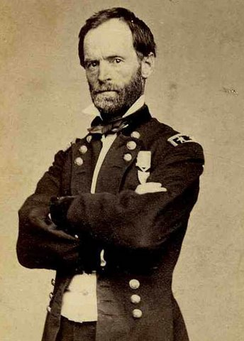
Sherman’s March
Date: July 20 – September 3, 1864
Location: Atlanta, GA to the Sea (Savannah, GA)
Commanding Officer(Confederate): General John Hood
Commanding Officer (Union): General William Sherman
Results: The siege of Atlanta by General Sherman ended with the burning of the city by Union troops. After burning the city, Sherman began his famous march to the sea, during which his troops looted and plundered their way across Georgia, destroying nearly everything in their path. The Union lost 31,623 and the Confederacy lost 35,004 and was a Union victory.

Slide 9
Sherman’s March
Sherman’s instructions from Grant:
Leave nothing to invite the enemy to return. Destroy whatever cannot be consumed.
Sherman’s troops burned the city of Atlanta. They ripped up railroad tracks, burned homes, barns, and factories.
Total War: Everyone is affected as the army destroyed food and equipment that might be useful to the enemy. Total War caused hardships for civilians in the south.

Slide 10
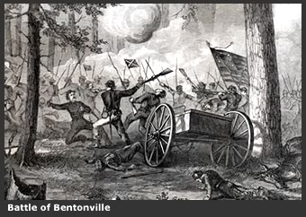
Bentonville
Date: March 9-21, 1865
Location: Bentonville, NC
Commanding Officer(Confederate): General Joseph E. Johnston
Commanding Officer (Union): General William Sherman
Results: The battle was the last full scale battle of the Civil War. On April 26, 1865, Johnston laid down Confederate arms on Sherman's terms at the Bennett Place near Durham, in the largest troop surrender of the American Civil War.

Slide 11
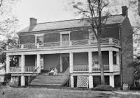
Appomattox
Date: April 9, 1865
Location: Appomattox, Virginia
Commanding Officer(Confederate): General Robert E. Lee
Commanding Officer (Union): General Ulysses S. Grant
Results: Lee surrendered to Grant at the court house in Appomattox, Virginia. The papers of formal surrender were signed in the home of Wilmer Mclean, whose first house was damaged during the first battle of the Civil War.

